Slide 1
PFOA TRAINING SESSION #1
LIBERTY BAPTIST
July 13, 2021
7:00 PM

Slide 2
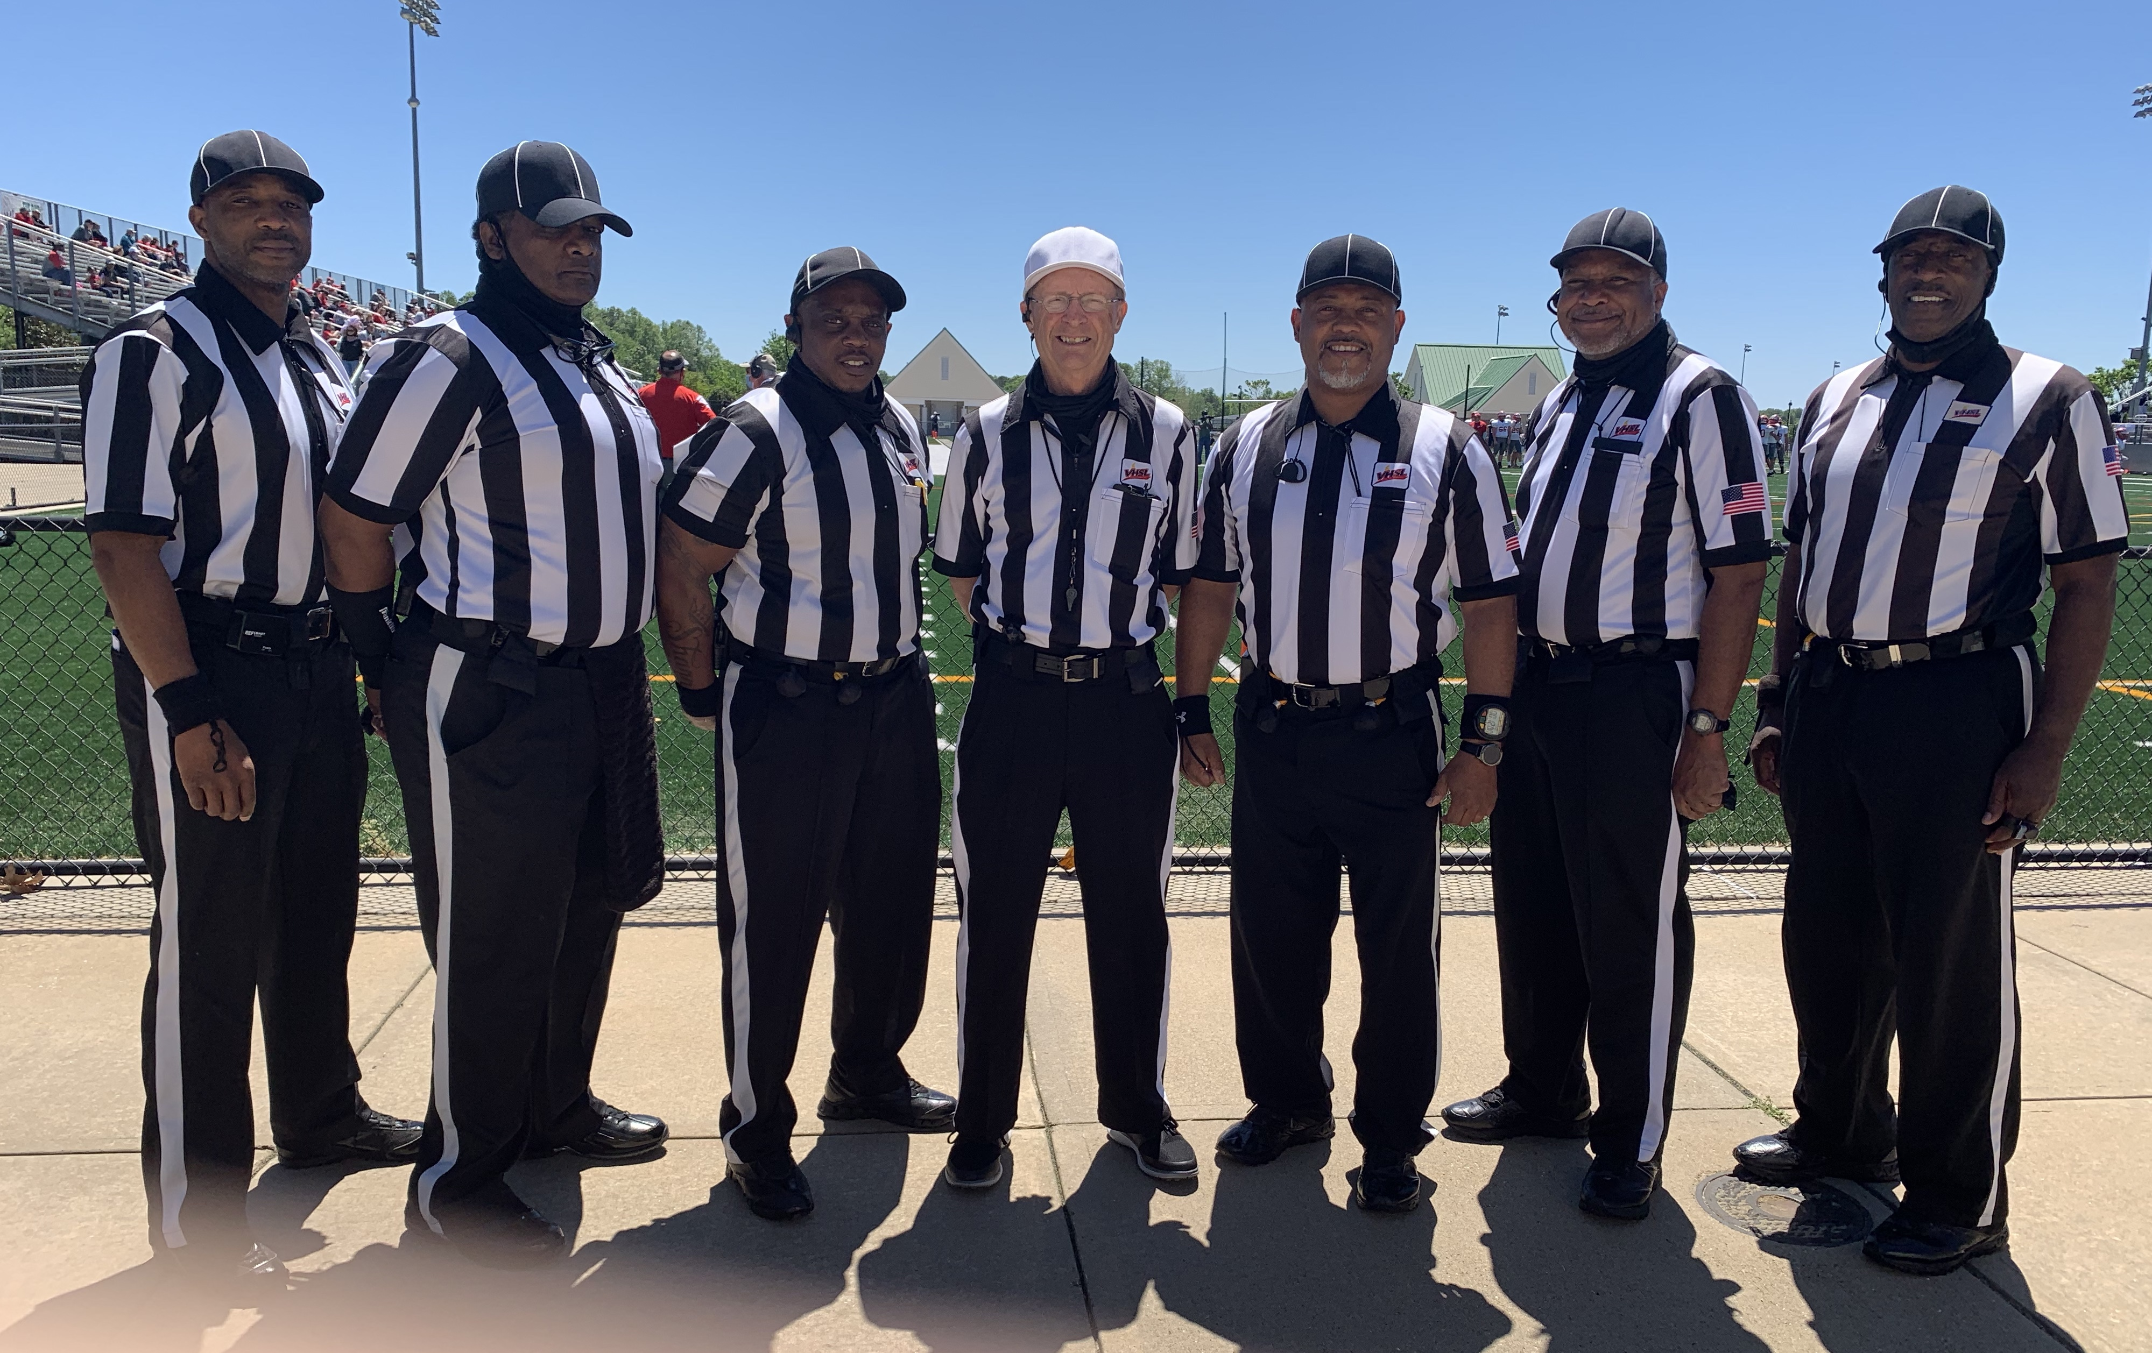
ROLL CALL
Listen Up!
Did I Hear Cowboys
HERE!
Present!
Aqui
Si!
YO!

Slide 3
President’s Report
Implicit
Bias
Training

Slide 4
PFOA Constitution & By-Laws Article XVIII Amendment
ARTICLE XVIII – AMENDMENT OF BY-LAWS
All proposed amendments to the By-Laws shall be presented in writing to the Board for its review. Thereafter, they shall be made available to the membership via email and/or posted online (PFOA website, Arbiter, or other location deemed appropriate by the Board) providing ready access to the membership to review all proposed amendments. The proposed amendment(s) shall then be considered as a new business item at a regular meeting of the PFOA, at which time the President shall provide the membership with the recommendation of the Board. The proposed amendment shall be voted on at the next regular meeting of the PFOA following the one in which the proposed amendment was considered. (See Article XIV, Sec. 4 for voting procedure).

Slide 5
President’s Report (Cont.)
HOF Committee: Bill Dozier +3
- Art XX
Chris Owens MPNOA Committee: Eddie Raines, +4 (TBD)
- Art XXI
Election Committee: Reginald Stanley +2
- Robert’s Rules of Order
Recruitment: Steve Hagwood

Slide 6
RECRUITMENT
- FLYER
DISTRO
- BUSINESS
CARDS
RECRUIT
RECRUIT
RECRUIT
RECRUIT
RECRUIT
RECRUIT
ON-GOING EFFORT BY ALL
2021 & 2022 FALL SEASONS

Slide 7
Commissioner’s Comments
Contact Information:
CELL PHONE: (757) 870-9808 (Cell)
E-MAIL: jnmayhew@verizon.net
Program this information into your cell phones

Slide 8
R E M I N D E R S
ALL MEMBERS MUST…..
Register on-line at https://www.whistle.vhsl.org – open 7/6 – 8/23
Complete the V.H.S.L. OFFICIALS CLINIC via Whistle & Zoom, 7/6 – 8/23
TAKE THE 2021 N.F.H.S. Pt.1 EXAM! 7/14 – 8/23
Passing Score Minimum of 75%
Minimum Score 85% or Higher for V.H.S.L. Post Season
$50 fee if you complete Clinic or Test late
Complete the NFHS Implicit Bias Course – MANDATORY
OFFICIAL CALL EQUIPMENT REP – 27 JULY @ 5:30 PM
NO ASSIGNMENTS WITHOUT COMPLETING ALL THE ABOVE!!

Slide 9
Rules 1 & 2 Training
CHANGE -- BLOCKING BELOW WAIST:
WHERE: ONLY IN THE FBZ
WHO: ONLY BY LINEMEN WHO WERE IN THE FBZ AT THE SNAP AGAINST OTHER LINEMEN
WHEN -- IMMEDIATELY AFTER THE SNAP
NO DELAYS
NO LIMITATION ON STANCE (2, 3,4-MAY STILL BBW IF IMMEDIATE)
QUESTION: CAN YOU BLOCK AN AIRBORNE PLAYER BELOW THE WAIST?

Slide 10
Rules 1 & 2 Training
RULE 1
PLAYER EQUIPMENT -- WE ARE NOT THE UNIFORM POLICE, BUT…
PLAY CARDS
TOWELS
BACK PADS
KNEE PADS

Slide 11
Rules 1 & 2 Training
RULE 2 – YOU MUST KNOW THE DEFINITIONS
EXAMPLES:
ALL BLIND SIDE BLOCKS ARE ILLEGAL. TRUE OR FALSE?
IT IS LEGAL TO HURDLE A PLAYER WHO HAS A KNEE ON THE GROUND. TRUE OR FALSE?
IF THERE IS A DOUBLE FOUL DURING THE LAST TIMED DOWN OF A PERIOD, THE PERIOD IS AUTOMATICALLY EXTENDED? TRUE OR FALSE?

Slide 12
Rules 1 & 2 Training
RULE 2 – CONTINUED EXAMPLES
AT THE SNAP, A60 AND A70 BOTH FIRE OUT AND BLOCK B75 WHO IS IN THE GAP BETWEEN THE TWO A LINEMEN. A60 BLOCKS B75 ABOVE THE WAIST AND A70 BLOCKS B75 BELOW THE WAIST. LEGAL OR ILLEGAL?
A CHOP BLOCK WITHOUT DELAY IS LEGAL? TRUE OR FALSE?

Slide 13
General Test Questions
4th & 10 at team K’s 5-yard line. K1 is standing in his end zone when he punts. The ball crosses the expanded neutral zone and strikes R’2s helmet. The ball bounces back into team K’s end zone, where K3 recovers and carries it to team K’s 10-yard line.
The ball becomes dead when K3 recovers in his end zone. Safety.
The ball becomes dead when K3 recovers in his end zone. Touchback
1st & 10 for team K from its 10-yard line.
Since K3 didn’t advance beyond the line to gain, its 1st & goal for team R from team K’s 10-yard line.

Slide 14
General Test Questions
2. 4th & 10 at team R’s 40-yard line. K1’s untouched punt bounces in team R’s end zone. During the kick, R2 blocks K3 below the waist at team R’s 25-yard line.
The penalty is enforced from the previous spot.
The penalty is enforced from the spot of the foul.
The penalty is enforced from team R’s 20-yard line.

Slide 15
General Test Questions
3. A 3rd & 2 at B-30. A10 Throws a pass from the B-32 that hits the ground. The Line Judge punches back. The grounded ball is muffed by B80 and goes OOB at B-27.
1st & 10 for A at B-27
4th & 2 for A at B-30.

Slide 16
General Test Questions
3. A 3rd & 2 at B-30. A10 Throws a pass from the B-32 that hits the ground. The Line Judge punches back. The grounded ball is muffed by B80 and goes OOB at B-27.
During the play, A15 blocks B55 below the waist at the B-25 and B accepts the BBW foul.
3rd & 12 for A from B-40.
3rd & 17 for A from B-45
3rd & 14 for A from B-42

Slide 17
Next Meeting(s)
Tuesday, Jul 20th @ 7PM (Liberty Baptist)
Rules 3 and 5
Pre-Game Conference/Game Management/Interaction w/Coaches
“Football” New Guys (“FNGs”) – Every Tuesday & Thursday, 7PM

