Slide 1
PFOA TRAINING SESSION #2
LIBERTY BAPTIST
July 20, 2021
7:00 PM

Slide 2
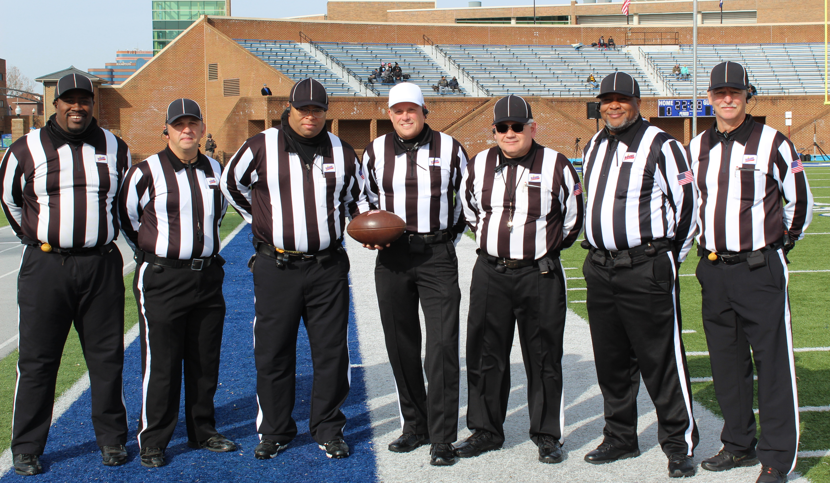
ROLL CALL

Slide 3
President’s Report
Implicit Bias Training Reminder
Crew Announcements
Denton: Chris Polyson as “H” & Phil McKenna as Deep “TBD”
Geer: Chris Moller as “U” & Drew Martin as “S”
Jimenez: Skip Perry as “S” & another Deep opening TBD
Young: Calvin Hunt as “F” or “S”, Robinson moves to “B” & another Deep position TBD

Slide 4
RECRUITMENT
- FLYER
DISTRO
- BUSINESS
CARDS
RECRUIT
RECRUIT
RECRUIT
RECRUIT
RECRUIT
RECRUIT
ON-GOING EFFORT BY ALL
2021 & 2022 FALL SEASONS

Slide 5
R E M I N D E R S
ALL MEMBERS MUST…..
Register on-line at https://www.whistle.vhsl.org – open 7/6 – 8/23
Complete the V.H.S.L. OFFICIALS CLINIC via Whistle & Zoom, 7/6 – 8/23
TAKE THE 2021 N.F.H.S. Pt.1 EXAM! 7/14 – 8/23
Passing Score Minimum of 75%
Minimum Score 85% or Higher for V.H.S.L. Post Season
$50 fee if you complete Clinic or Test late
Complete the NFHS Implicit Bias Course – MANDATORY
OFFICIAL CALL EQUIPMENT REP – 27 JULY @ 5:30 PM
NO ASSIGNMENTS WITHOUT COMPLETING ALL THE ABOVE!!

Slide 6
Pre-Game Conference
Set the Tone
Attitude, Appearance, Demeanor and Professionalism
Empathy (Heavily invested & dealing w/15-18 year olds)
Work w/you; not Against You (Control of their Team)
On-Field Meeting
Introductions and Crew Game Cards
Pre-Game Checklist (Team info, equip, timing, etc.)
Open Dialogue (Questions = Answers; Fouls > Penalties)
Coaches Boxes

Slide 7
Game Management/Coach Interaction
Communicate Info (Good or Bad)
Foul/Penalty Info; Player Assistance, Leaky Formations
Only communicate what you know; not what you think
Not your Friend, and Not Your Foe
Assistants/Position Coaches
See areas we might not
Decipher and Decide when/what to pass along to Crew
Respect is two-way street
Conferences (Time-Outs)

Slide 8
Post Game
Exit Strategy
Leave Field Promptly w/Crew, but not Hurriedly
No extended Conversations/Handshakes
Be Aware of Coaches’ Emotions (Good or Bad)
Silence is Golden (Can NEVER be Mis-Quoted)
Ignore Uncomplimentary Comments
Head Held High
Save any Discussions for the Locker Room

Slide 9
Rules Questions 3 & 5
1. K’S SHORT POOCH KICKOFF IS TOUCHED BY K-10 AT R’S 45 AND GOES OOB. GAME CLOCK STARTS WHEN K-10 TOUCHES BALL? T/F
TRUE-THIS IS NOT FIRST TOUCHING. FIRST TOUCHING ONLY OCCURS IN NZ ON FREE KICK. 2-12-1
2. K IS PENALIZED FOR FREE KICK OOB? T/F
TRUE 5 YARD PENALTY FOR KICK OOB UNTOUCHED BY R. 1/10 FOR R AT 50. 6-1-9B & 10-4-2 EXCEPTION

Slide 10
Rules Questions 3 & 5 (Cont.)
3. K’S GROUNDED, ATTEMPTED OSK IS TOUCHED BY K-10 AT K-45 AND GOES OOB. GAME CLOCK STARTS WHEN K-10 TOUCHES BALL? T/F
FALSE TOUCHING IN NZ IS FIRST TOUCHING
4. K IS PENALIZED FOR FREE KICK OOB? T/F
TRUE, EVEN THOUGH K CAN RECOVER AND POSSESS FK, IT IS A FOUL SINCE FK IS UNTOUCHED BY R. 10-4-2 EXCEPTION AND 6-1-9 B

Slide 11
Rules Questions 3 & 5 (Cont.)
5. IN THE SECOND QUARTER, A-10 RUNS FOR A FIRST DOWN. THERE IS A LATE HIT OUT OF BOUNDS. TIME EXPIRES ON THE PLAY. THERE WILL BE AN UNTIMED DOWN. T/F
FALSE, FOUL DID NOT OCCUR DURING THE DOWN IN WHICH TIME EXPIRED. DEAD BALL FOUL SUCCEEDING SPOT, 2ND HALF KO. 3-3-3 (NO UNTIMED DOWN) AND 3-3-6 (FOUL AFTER TIME EXPIRES – SUCCEEDING SPOT.

Slide 12
Rules Questions 3 & 5 (Cont.)
6. K-10 KICKS A SUCCESSFUL FG AND R-2 ROUGHS THE KICKER. TIME FOR THE PERIOD EXPIRES ON THE PLAY. K ELECTS TO TAKE THE RESULT OF THE PLAY AND ADMINISTER PENALTY FROM SUCCEEDING SPOT. THERE WILL BE AN UNTIMED DOWN? T/F
FALSE-3-3-4a PENALTY ADMINSTERED ON THE SUCCEEDING KICKOFF.

Slide 13
Rules Questions 3 & 5 (Cont.)
7. A’S BALL, 2ND AND 5 AT THE B 15. A-10’S PASS IS INTERCEPTED AT THE B -3. B RETURNS TO THE B-20 WHERE HE FUMBLES. A-50 RECOVERS AT THE B-22.
a. A’S BALL 3RD AND 12 AT THE SPOT OF RECOVERY.
b. A’S BALL 1ST AND 10 AT THE SPOT OF RECOVERY.
B IS CORRECT ANSWER, A GETS A NEW SERIES. 5-1-3d THE LTG NO LONGER EXISTS AFTER THE COP (SINCE THERE IS NO PENALTY)

Slide 14
Rules Questions 3 & 5 (Cont.)
7.a. WHEN DOES THE GAME CLOCK START? RFP? SNAP?
A 1/10 NEW SERIES, GAME CLOCK ON RFP (“ABA READY FOR PLAY” CHANGE OF POSSESSION) 3-4-2 a (NOTE B WAS NOT AWARDED A NEW SERIES SO 3-4-3b is not in effect.)

Slide 15
Rules Questions 3 & 5 (Cont.)
8. BALL CARRIER A-10 GOES OUT OF BOUNDS. THE GAME CLOCK FAILS TO STOP AND CONTINUES TO RUN. A THEN RUNS ANOTHER PLAY. THE A COACH CALLS T/O AND INFORMS THE R THAT THE GAME CLOCK DID NOT STOP WHEN A-10 WENT OOB. CAN R CORRECT THE GAME CLOCK?
YES, HE CAN CORRECT BEFORE 2ND LIVE BALL 3-4-8. AS A MECHANICS POINT-OFFICIAL WHO RULES OOB HAS GOT TO SIGNAL AND LOOK AT CLOCK!

Slide 16
Rules Questions 3 & 5 (Cont.)
9. TEAM A IS LEADING 13-7 WITH UNDER TWO MINUTES REMAINING IN THE GAME. A’S BALL 2ND AND 10 WITH THE GAME CLOCK RUNNING AND B HAS NO TIMEOUTS REMAINING. A50 FALSE STARTS. AFTER THE PENALTY IS ADMINISTERED, THE GAME CLOCK STARTS ON THE RFP. T/F
MAYBE, THIS IS B’S OPTION. THEY CAN ELECT TO START ON SNAP. THIS RULE IS TO PREVENT A FROM CONSUMING TIME FROM INTENTIONAL FOULS TO GET A NEW PLAY CLOCK. 3-4-7 R ALSO HAS AUTHORITY UNDER 3-4-6 TO DO THIS AS WELL BUT MANY REFEREES FAILED TO USE THIS AUTHORITY!

Slide 17
Rules Questions 3 & 5 (Cont.)
10. B-20’S HELMET COMES OFF DURING THE PLAY. THERE IS NO FOUL. AN OFFICIALS TIME OUT IS CALLED WHEN THE PLAY ENDS. T/F?
TRUE. WE ALL NEED TO GET BETTER ON THIS AS WE SOMETIMES FAIL TO STOP GAME CLOCK. 3-5-10d. THIS OFFICIALS TIME OUT WILL STOP THE GAME AND PLAY CLOCK UNTIL A NEW B PLAYER HAS ENTERED!

Slide 18
Rules Questions 3 & 5 (Cont.)
11. TEAM A, 3RD AND 7 AT B 20. REPLACED PLAYER A79 IS TRYING TO LEAVE THE FIELD BUT IS STILL ON THE FIELD WHEN THE BALL IS SNAPPED. A-79 DOES NOT PARTICIPATE. A-20 RUNS THE BALL TO THE B10. AFTER PENALTY ADIMINSTRATION?
a. A 3RD AND 12 AT B 25.
b. A 3RD AND 2 AT B 15.
c. A 1ST AND 10 AT THE B 15
C IS CORRECT. THIS IS A NON PLAYER FOUL. ALL NON PLAYER FOULS ARE ADMINISTERED FROM THE SUCCEEDING SPOT. A REACHED THE LTG AND A 1ST DOWN IS AWARDED. PENALTY ADMINISTERED AND CHAINS SET. 5-1-2a!

Slide 19
Rules Questions 3 & 5 (Cont.)
12. A 4TH AND 5 AT THE B 10. RUNNER A-10 GOES OOB AT THE B-7. THERE IS A LATE HIT OOB BY B.
1ST AND GOAL FOR A AT B-3.5
1ST AND 10 FOR B AT B-3.5
CORRECT ANSWER IS B; TURN OVER, B ½ DISTANCE, 1ST AND 10.

Slide 20
Rules Questions 3 & 5 (Cont.)
13. TEAM A SECOND AND TEN AT B 40. A RUNS FOR 1 YARD GAIN AND A IS FLAGGED FOR ILLEGAL SHIFT. B DECLINES PENALTY, BUT DOWN BOX REMAINS SHOWING 2ND DOWN. A RUNS TWO MORE PLAYS TO B-33 (SHORT OF THE LTG). BOX NOW SHOWS 4TH DOWN. COACH FOR B TAKES TIME OUT AND TELLS R OF THE ERROR. CAN R CORRECT THE ERROR? IF SO, WHAT IS THE DOWN AND DISTANCE?
CORRECTABLE BEFORE THE BALL BECOMES LIVE AFTER A NEW SERIES IS AWARDED. A HAD ITS 4 DOWNS AND FAILED TO MAKE LTG. 5-1-1b NEVER LET THIS HAPPEN!

Slide 21
Rules Questions 3 & 5 (Cont.)
14. A RUNS FOR A FIRST DOWN. AFTER HE GETS UP HE THROWS THE TACKLER TO THE GROUND. HE IS FLAGGED FOR A DEAD BALL PF. THE R ERRONEOUSLY SETS THE CHAINS AND THEN ADMINISTERS THE 15 YARD PENALTY SETTING UP 1ST AND 25. A THROWS AN INCOMPLETE PASS. AFTER THAT PLAY, A COACH CALLS TIME OUT AND THE REFEREE REALIZES HE SHOULD NOT HAVE SET THE CHAINS BEFORE ADMINISTERING THE PENALTY. IS THIS CORRECTABLE?
NO. AFTER THE BALL WAS LEGALLY SNAPPED, THERE CAN BE NO CORRECTION OF THE DOWN OR DISTANCE. 5-1-1 SITUATION E CASEBOOK.

Slide 22
Next Meeting(s)
Tuesday, Jul 20th @ 7PM (Liberty Baptist)
Rules 6 and 7
Tandem Break-Outs (R/U; H/L; S/F/B)
“Football” New Guys (“FNGs”) – Every Tuesday & Thursday, 7PM

