Slide 1
PFOA TRAINING SESSION #5 Ball In Play & Scoring Rules 4 & 8
LIBERTY BAPTIST
August 10, 2021
7:00 PM

Slide 2
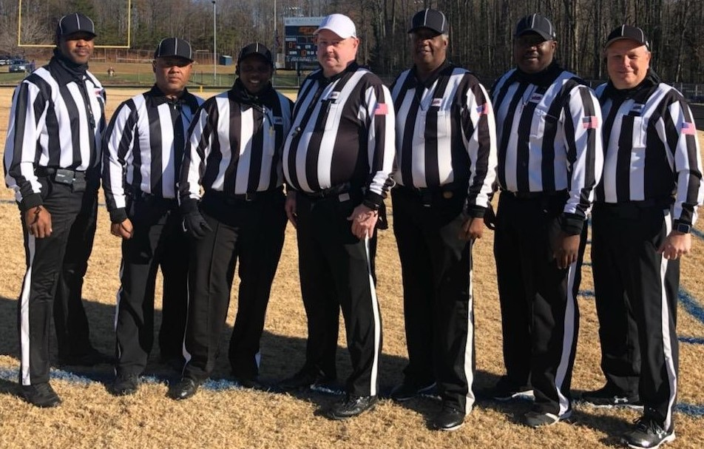
ROLL CALL

Slide 3
President’s Report
Arbiter Acceptance/Declination
Eligibility Questions
Scrimmage Safety Talk – Rescheduling
Band Play

Slide 4
RECRUITMENT
- FLYER
DISTRO
- BUSINESS
CARDS
RECRUIT
RECRUIT
RECRUIT
RECRUIT
RECRUIT
RECRUIT
ON-GOING EFFORT BY ALL
2021 & 2022 FALL SEASONS

Slide 5
R E M I N D E R S
ALL MEMBERS MUST…..
Register on-line at https://www.whistle.vhsl.org – open 7/6 – 8/23
Complete the V.H.S.L. OFFICIALS CLINIC via Whistle & Zoom, 7/6 – 8/23 – Register and view Zoom Recording
TAKE THE 2021 N.F.H.S. Pt.1 EXAM! 7/14 – 8/23
Passing Score Minimum of 75%
Minimum Score 85% or Higher for V.H.S.L. Post Season
$50 fee if you complete Clinic or Test late
Complete the NFHS Implicit Bias Course – MANDATORY
OFFICIAL CALL EQUIPMENT REP – 10 Aug @ 5:30 PM
NO ASSIGNMENTS WITHOUT COMPLETING ALL THE ABOVE!!

Slide 6
IMPLICIT BIAS COURSE & VHSL REGISTRATION
Go to nfhslearn.org and search for the Implicit Bias Course.
When finished send the Certificate to Jimmy via email.
Please register if not already accomplished

Slide 7
SCORING
WE HAVE COVERED A LOT OF THESE RULES IN PLAY SITUATIONS.
TOUCHDOWN
POSSESION OF LIVE BALL IN OPPONENT’S END ZONE ( EARLIER DISCUSSION REGARDING G/L EXTENDED-ONLY IF R TOUCHING IB)

Slide 8
SCORING
CARRY OVER FOULS ON SCORING PLAYS:
FOUL ON SCORING PLAY RULE CHANGED YEARS AGO BECAUSE OF CHEAP FOULS ON SCORING PLAYS
TRY OR SUBSEQUENT KICKOFF (NOTE THIS LANGUAGE. THERE IS DIFFERENT LANGUAGE FOR TRIES AND FIELD GOALS FOR POSSIBLILTY OF OVERTIME-ONLY SUCCEEDING SPOT CARRY OVER

Slide 9
TRY
TRY -- 3 YARD LINE -- WHEN DOES IT END:
B POSSESSION, APPARENT KICK TRY WILL NOT SCORE, SUCCESSFUL, DEAD BALL
ONLY A MAY SCORE ON A TRY

Slide 10
TRY
PLAY: K SCORES ON LAST DOWN OF GAME AND KICKS THE TRY TO TIE GAME 14-14.
K KICKER IS ROUGHED. WHAT ARE OPTIONS FOR K?
- ACCEPT PENALTY AND REPLAY DOWN FROM R 1.5 YARD LINE.
- ACCEPT RESULT OF PLAY (SUCCESSFUL TRY) AND PENALIZE FROM SUCCEEDING SPOT.) R MUST CAREFULLY EXPLAIN!

Slide 11
TRY & FIELD GOAL
ARTICLE 9 -- DON’T ASK WHICH TEAM TO K.O
FIELD GOAL
PLACE OR DROP KICK FROM SCRIMMAGE, OR FREE KICK FOLLOWING A FAIR CATCH OR AWARDED F/C.
R FOUL, PENALTY BY R
YARDAGE PLUS REPLAY
OR SUCCEEDING SPOT (OVERTIME ISSUE)

Slide 12
FORCE, SAFETY, TOUCHBACK.
FORCE – DEFINE P. 29
ONLY WITH GOAL LINE AND ONLY ONE DIRECTION FIELD OF PLAY TO EZ
PAGE 67: THERE IS RULEBOOK/EXAM FORCE & THERE IS OFFICIATING GAME FORCE -- BE CAREFUL WITH NEW FORCE ON GROUNDED FUMBLE, KICK OR BACKWARD PASS

Slide 13
FORCE, SAFETY, TOUCHBACK.
PLAY: K’S PUNT IS BLOCKED NEAR K’S 5 YARD LINE. K AND R ARE ATTEMPTING TO RECOVER. THE BALL GOES INTO K’S ENDZONE WHERE IT IS RECOVERED BY
1. K.
RESULT?
2. R.
RESULT?

Slide 14
FORCE, SAFETY, TOUCHBACK.
NOTE: MUFFING OR BATTING OF A PASS, KICK OR FUMBLE IN FLIGHT IS NOT A NEW FORCE!!
SAFETY: RUNNER CARRIES BALL ACROSS HIS OWN GOAL LINE AND DEAD THERE IN HIS TEAM POSSESSION.
MOMENTUM EXCEPTION. WHY?? PREVENT A SAFETY – ANOTHER 30+ YEAR OLD RULE. APPLIES: OPPONENT’S PASS, FUMBLE, KICK.

Slide 15
FORCE, SAFETY, TOUCHBACK.
TOUCHBACK – 1. ANY FREE OR SCRIMMAGE KICK WHICH IS NOT A SCORING ATTEMPT BREAKS R’S GOAL LINE. EVERYONE MUST MEMORIZE THIS!!
2. K RECOVERS KICK IN K’S END ZONE AND R FORCED IT ACROSS GOAL LINE! BE CAREFUL!! (I WANT TO SEE B POSSESS THE KICK, AND THEN FORCE INTO K’S END ZONE)

Slide 16
FORCE, SAFETY, TOUCHBACK.
3. FWD PASS INTERCEPTED IN B’S EZ AND BECOMES DEAD THERE IN B POSSESSION
4. A FUMBLE IS THE FORCE, OR A MUFF OR BAT OF A BACKWARD PASS OR A FUMBLE AFTER EITHER HAS TOUCHED THE GROUND IS THE NEW FORCE, WHICH SENDS THE BALL TO OR ACROSS THE OPPONENT’S GL & PROVIDED SUCH OPPONENT IS IN TEAM POSSESSION OR THE BALL IS OOB WHEN IT BECOMES DEAD ON OR BEHIND ITS GL.

Slide 17
FORCE, SAFETY, TOUCHBACK.
PLAY: A1 IS RUNNING TO B’S GOAL LINE AND STRETCHES THE BALL OUT TO PENETRATE THE GOAL LINE. A1 FUMBLES SHORT OF THE GOAL LINE. THE BALL IS RECOVERED BY B IN B’S END ZONE.
RESULT?
TOUCHBACK. HOPEWELL PLAY

Slide 18
FORCE, SAFETY, TOUCHBACK.
READ CASE BOOK PLAY 8.5.3A PAGE 73 -- PLEASE DO NOT MAKE THIS CALL.
PLAY: K 1 KICKS OFF. THE KICK IS GROUNDED AND R1 INTENTIONALLY KICKS IT THROUGH THE ENDZONE TO PREVENT K FROM RECOVERING.
RESULT? FORCE IS NOT A CONSIDERATION ON A KICK GOING INTO R’S EZ.

Slide 19
FORCE, SAFETY, TOUCHBACK.
ILLEGAL KICK. RESULT OF PLAY: TB (KICK INTO R’S EZ)
ENFORCEMENT: LOOSE BALL PLAY, PREVIOUS SPOT ENFORCEMENT.
CASE BOOK PLAY 8.5.3B

Slide 20
PUTTING THE BALL IN PLAY
FREE KICK; START EACH HALF; AFTER A TRY OR FIELD GOAL; AFTER A SAFETY
WHEN A FREE KICK DOWN IS REPLAYED
WHEN A FREE KICK IS CHOSEN FOLLOWING AFFAIR CATCH, AN AWARDED FAIR CATCH, THE REPLAY OF A DOWN WHICH FOLLOWS FAIR CATCH OR AWARDED F/C

Slide 21
PUTTING THE BALL IN PLAY
SNAP ALL THE OTHER TIME.
BALL REMAINS DEAD AND A DOWN IS NOT BEGUN IF DEAD BALL FOUL!!

Slide 22
DEAD BALL
DEAD BALL -- WHEN??
Page 47 Section 2
WHEN A RUNNER
• GOES OOB.
• HELD SO THAT FORWARD PROGRESS IS STOPPED
• ANY PART OF BODY OTHER THAN HAND OR FOOT TOUCHES GROUND

Slide 23
TRY FOR POINT
EXCEPTION:
ADDRESS HOLDER AND NOTE FOR KNEE LEAVING GROUND ON MUFF
DIFFERENT THAN ERRANT SNAP. PAGE 48. REFEREES MUST KNOW THIS COLD!

Slide 24
TRY FOR POINT
PLAY: TRY FOR POINT -- SNAP IS HIGH, HOLDER RISES AND CATCHES AND GOES BACK TO KNEE.
RESULT? BALL REMAINS LIVE- SEE PAGE 48.

Slide 25
TRY FOR POINT
PLAY: SNAP IS LOW AND BOUNCES TOWARD HOLDER. HOLDER RISES AND GRABS SNAP AND GOES BACK TO KNEE.
RESULT? BALL REMAINS LIVE

Slide 26
IW & LIVE BALL OOB
IW PAGE 48-49 -- ACCEPTED FOUL TRUMPS IAW!!!
SECTION 3 SPOTS -- KICKOFF OOB, R TAKES BALL ON 35 UMPIRES WHERE DO YOU SPOT IT??
IN BOUNDS SPOT (=HASH MARK)

Slide 27
LIVE BALL OOB
IF RUNNER GOES OOB -- SPOT IS POINT WHERE BALL CROSSES S/L
GOAL LINE EXTENDED (DIFFERENT THAN NCAA)
RULE 2 (PAGE 33 ARTICLE 3) RUNNER TOUCHING GROUND IN BOUNDS GETS G/L EXTENDED. DIVING DOES NOT, BUT SEE CB, PAGE 69 DIVES INTO PYLON, BALL HITS PYLON. TD. 8.2.1

Slide 28
Next Meeting(s)
Tuesday, Aug 17th @ 7PM (Liberty Baptist)
Rule 9 – Conduct of Players
Rule 10 – Penalty Enforcement
“Football” New Guys (“FNGs”) – Every Tuesday & Thursday, 7PM

